Slide 1
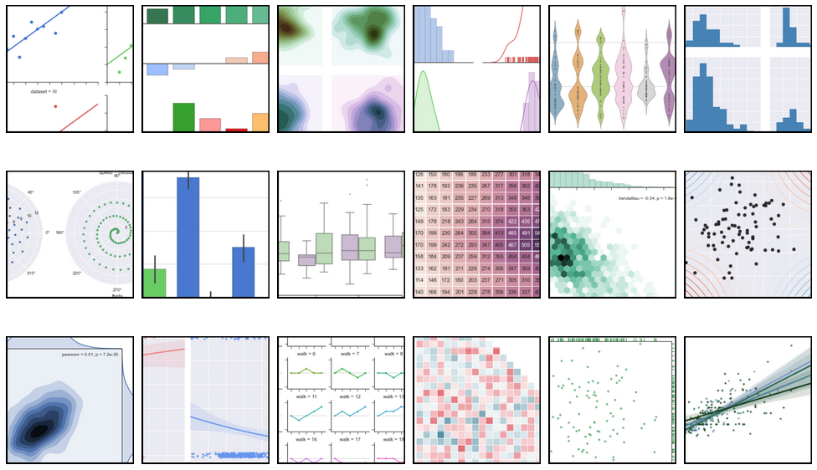
Plotting in Python
Zichen Wang
PhD Candidate, Ma’ayan Lab
3/17/2015

Slide 2
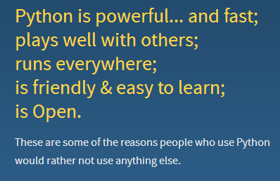
Why Python?
Elegant syntax
concise, human-readable
Extensive ranges of applications supported by third-party modules (packages)
Web development
Database
Scientific computing
Game development

Slide 3
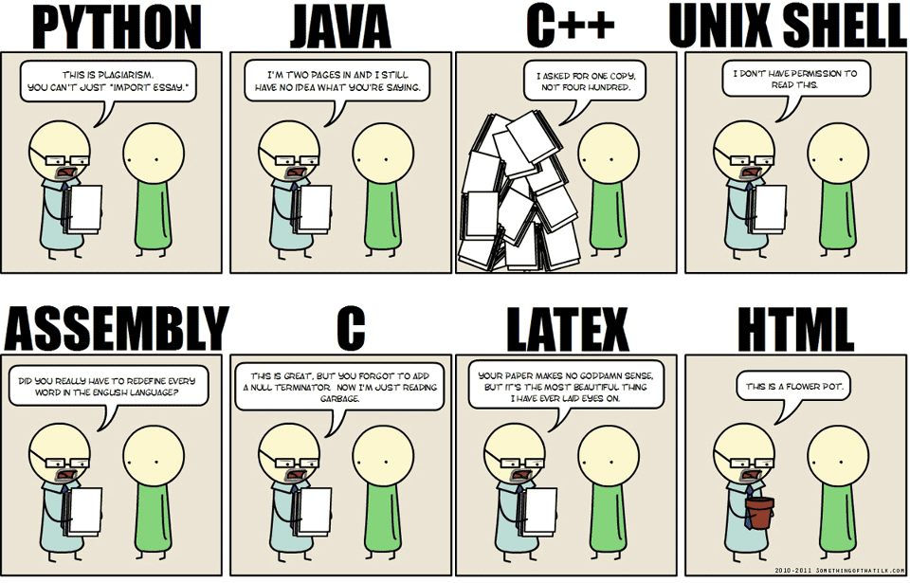
Import packages

Slide 4
Installing Python packages
Where to find them?
Official website of the package
Python Package Index(PyPI)https://pypi.python.org/pypi
A large collection of Windows binaries: http://www.lfd.uci.edu/~gohlke/pythonlibs/
Source code repositories: GitHub, Bitbucket
Types and install instructions:
Registered on PyPI: `pip install package`
.whl file: `pip install package.whl`
A directory with setup.py file: `python setup.py install`
.exe Windows binary: double click and follow the instructions

Slide 5
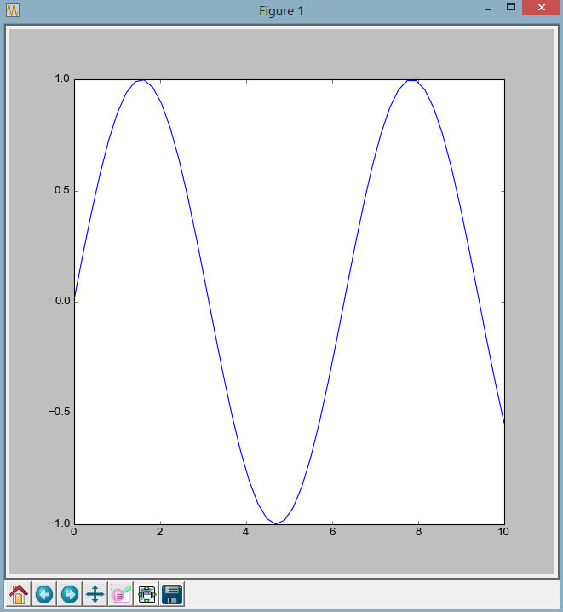
Plotting libraries in python
Matplotlib
The basic and stable 2D plotting library
Similar to MATLAB
Highly customizable figures
ggplot
Seaborn
Mpld3

Slide 6
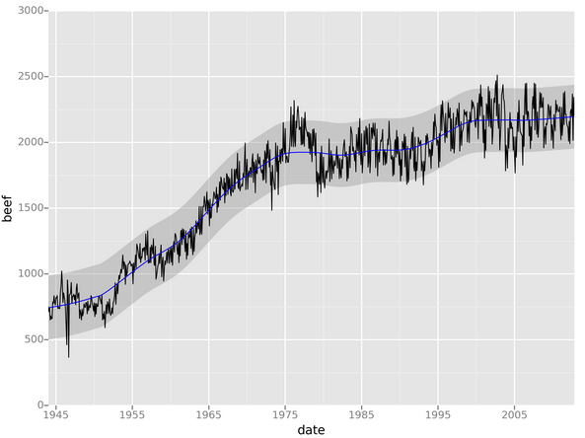
Plotting libraries in python
Matplotlib
ggplot
Professional looking figures
Similar to R’s ggplot2
Seaborn
Mpld3

Slide 7
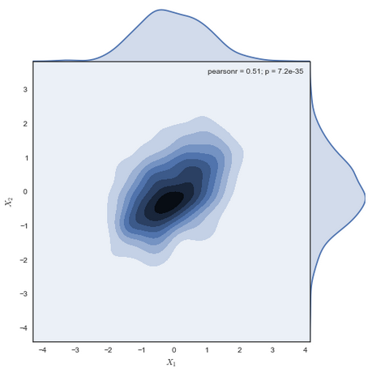
Plotting libraries in python
Matplotlib
ggplot
Seaborn (statistical data visualization)
Wrapper of Matplotlib
high-level interface for drawing attractive statistical graphics
Mpld3

Slide 8
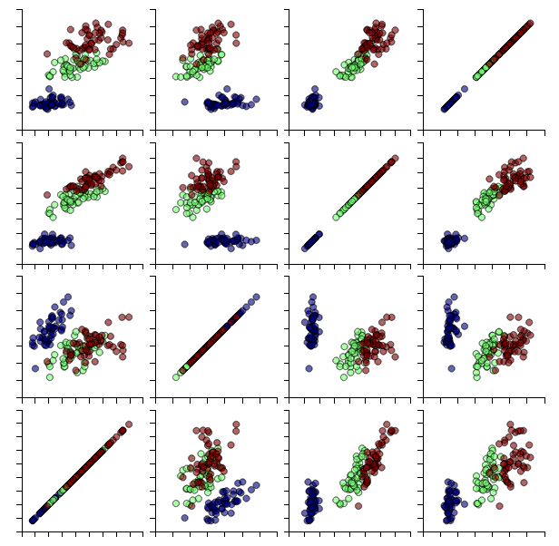
Plotting libraries in python
Matplotlib
ggplot
Seaborn
Mpld3
Bring together matplotlib and d3.js
Convert matplotlib figures to interactive web compatible figures

Slide 9
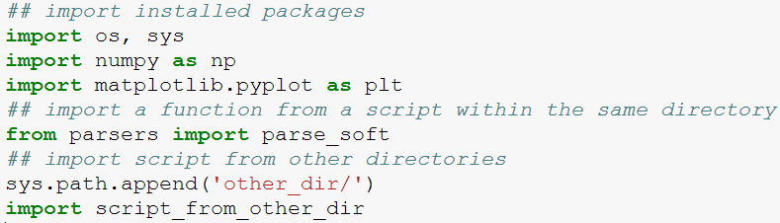
Get some data to plot
Download everything here:
https://github.com/wangz10/plot_with_python
How to import packages

Slide 10
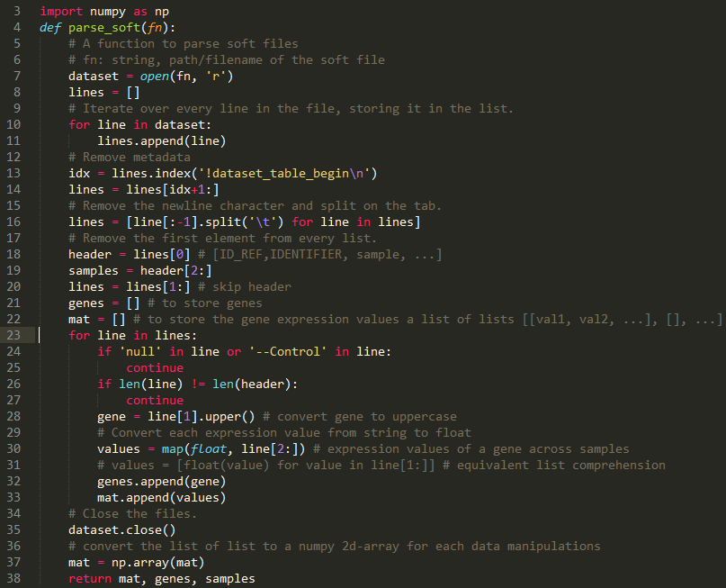
parsers.py

Slide 11
Numpy N-dementional array
A multidimensional container of items of the same type and size
Efficient for indexing and arithmetic operations
Creation:
From Python array_like objects: lists, tuples
Intrinsic numpy functions: np.arange, np.zeros
From files: np.loadtxt,
Indexing

Slide 12
Hands on
Get the data
Plot with matplotlib
Plot with seaborn
Plot with mpld3

Slide 13
Thanks for your attention!
Questions?
zichen.wang@mssm.edu

